Slide 1
Subset Data
Storyboard

Slide 2
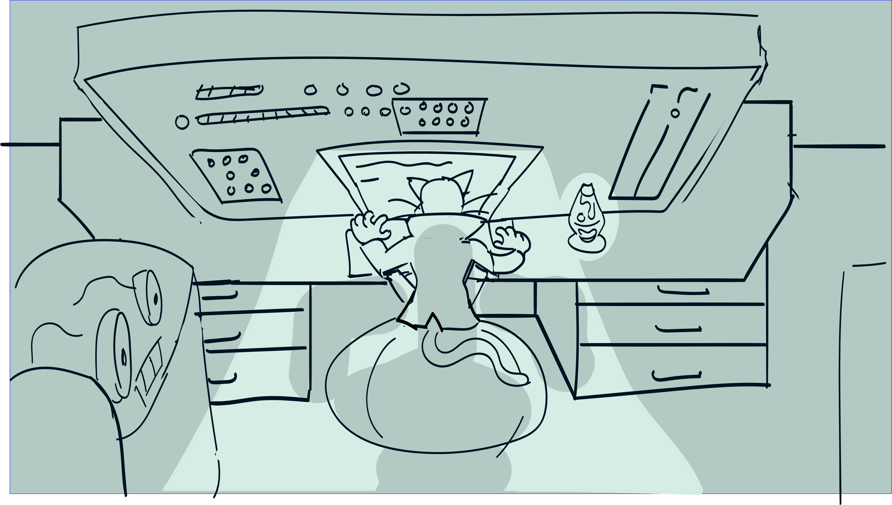


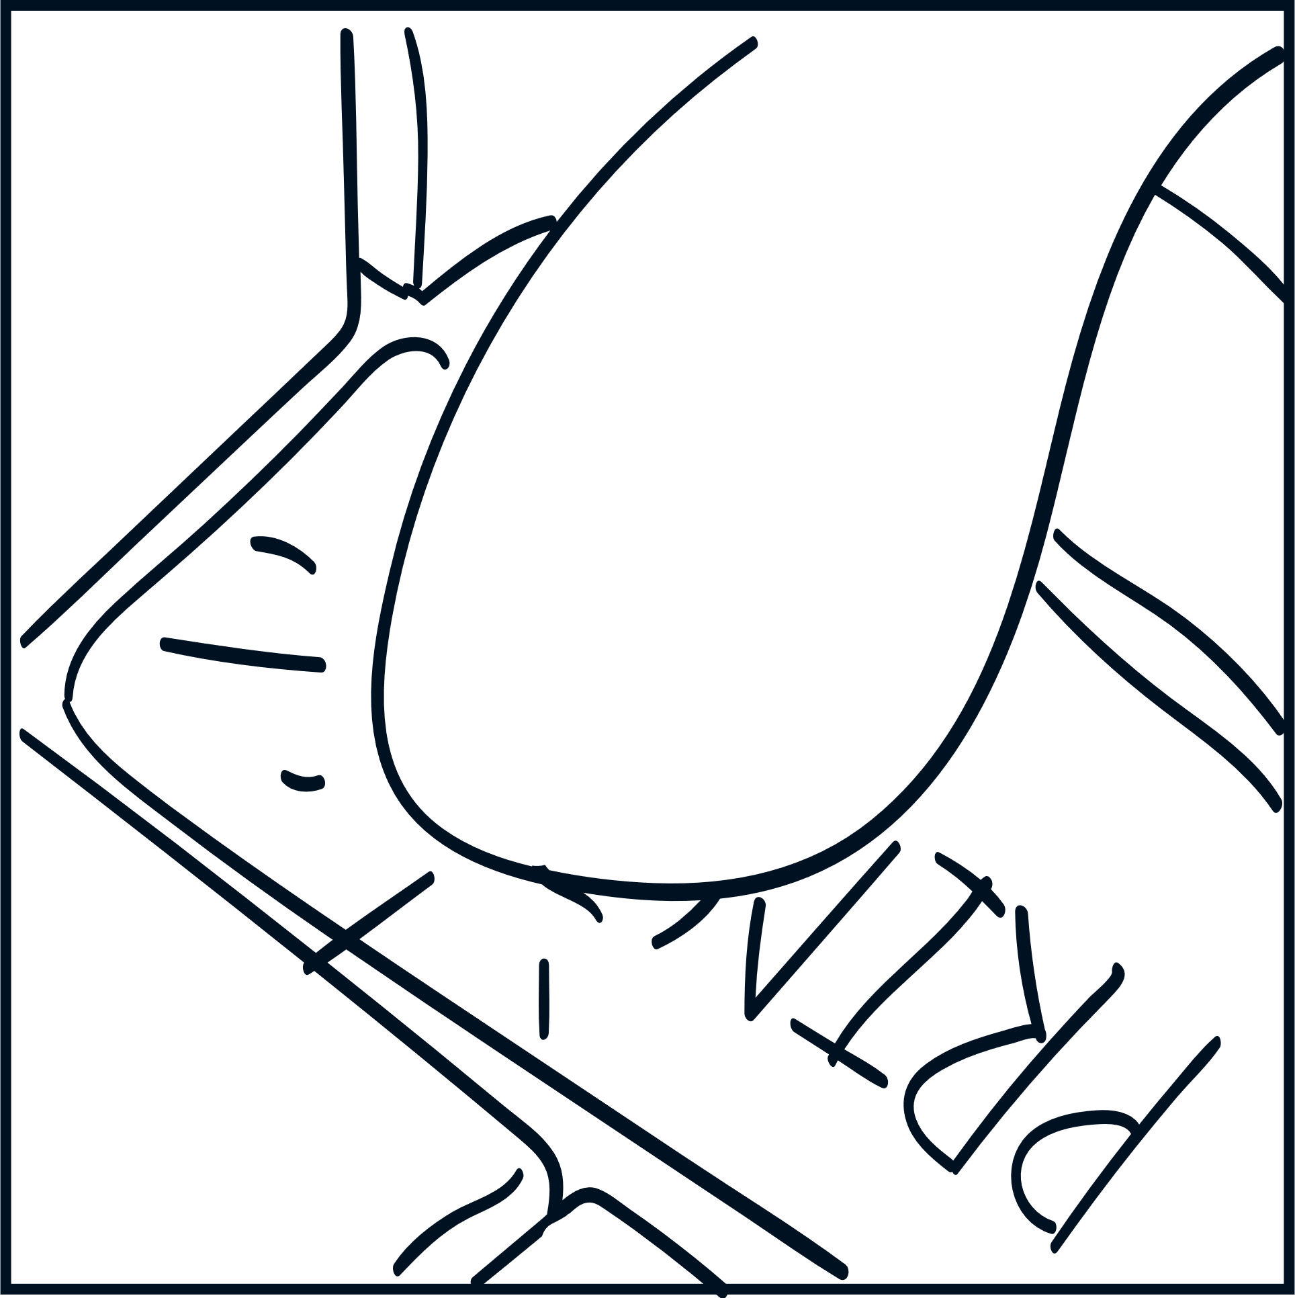

Slide 3
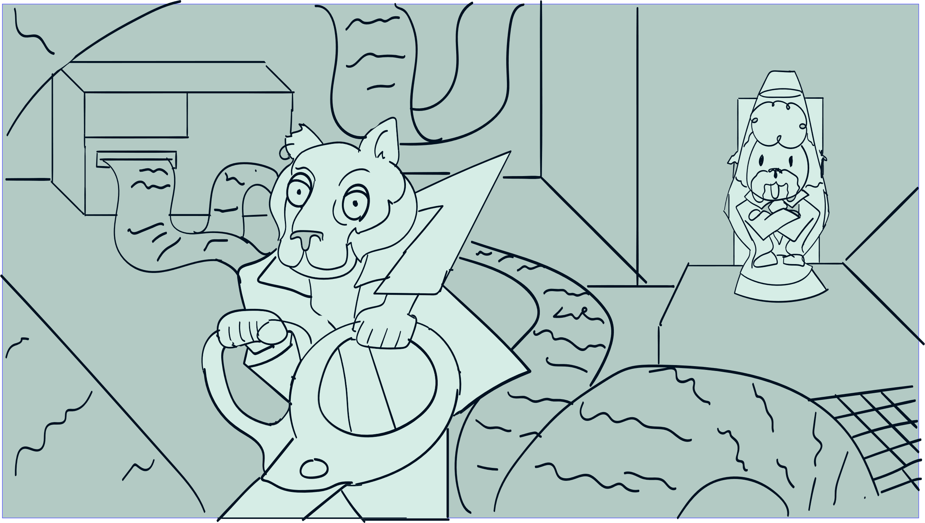


IT HAS TO BE REAL…
THE FOUNTAIN OF YOUTH JUST HAS TO BE REAL.
WHAT ARE YOU DOING?

Slide 4
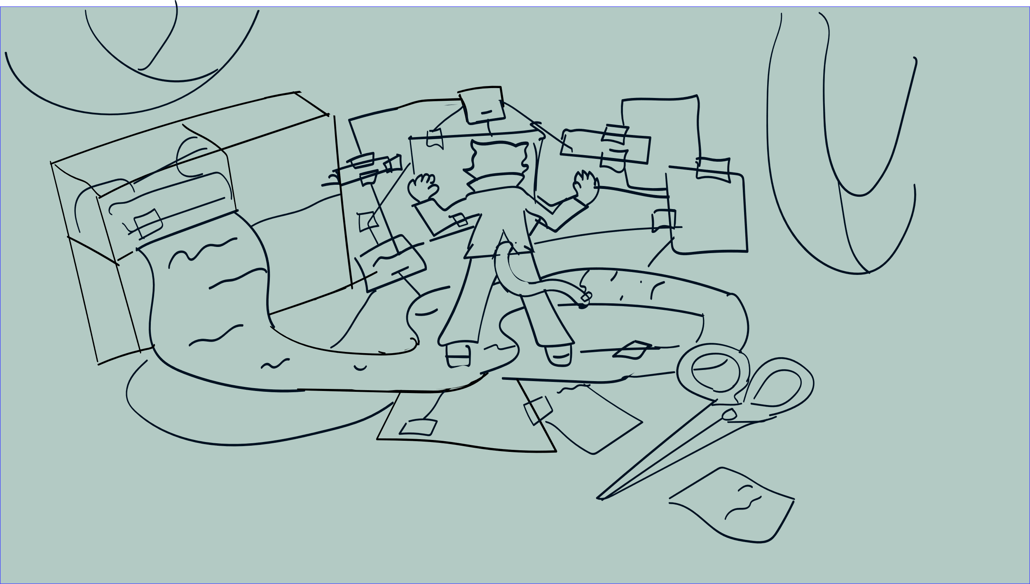
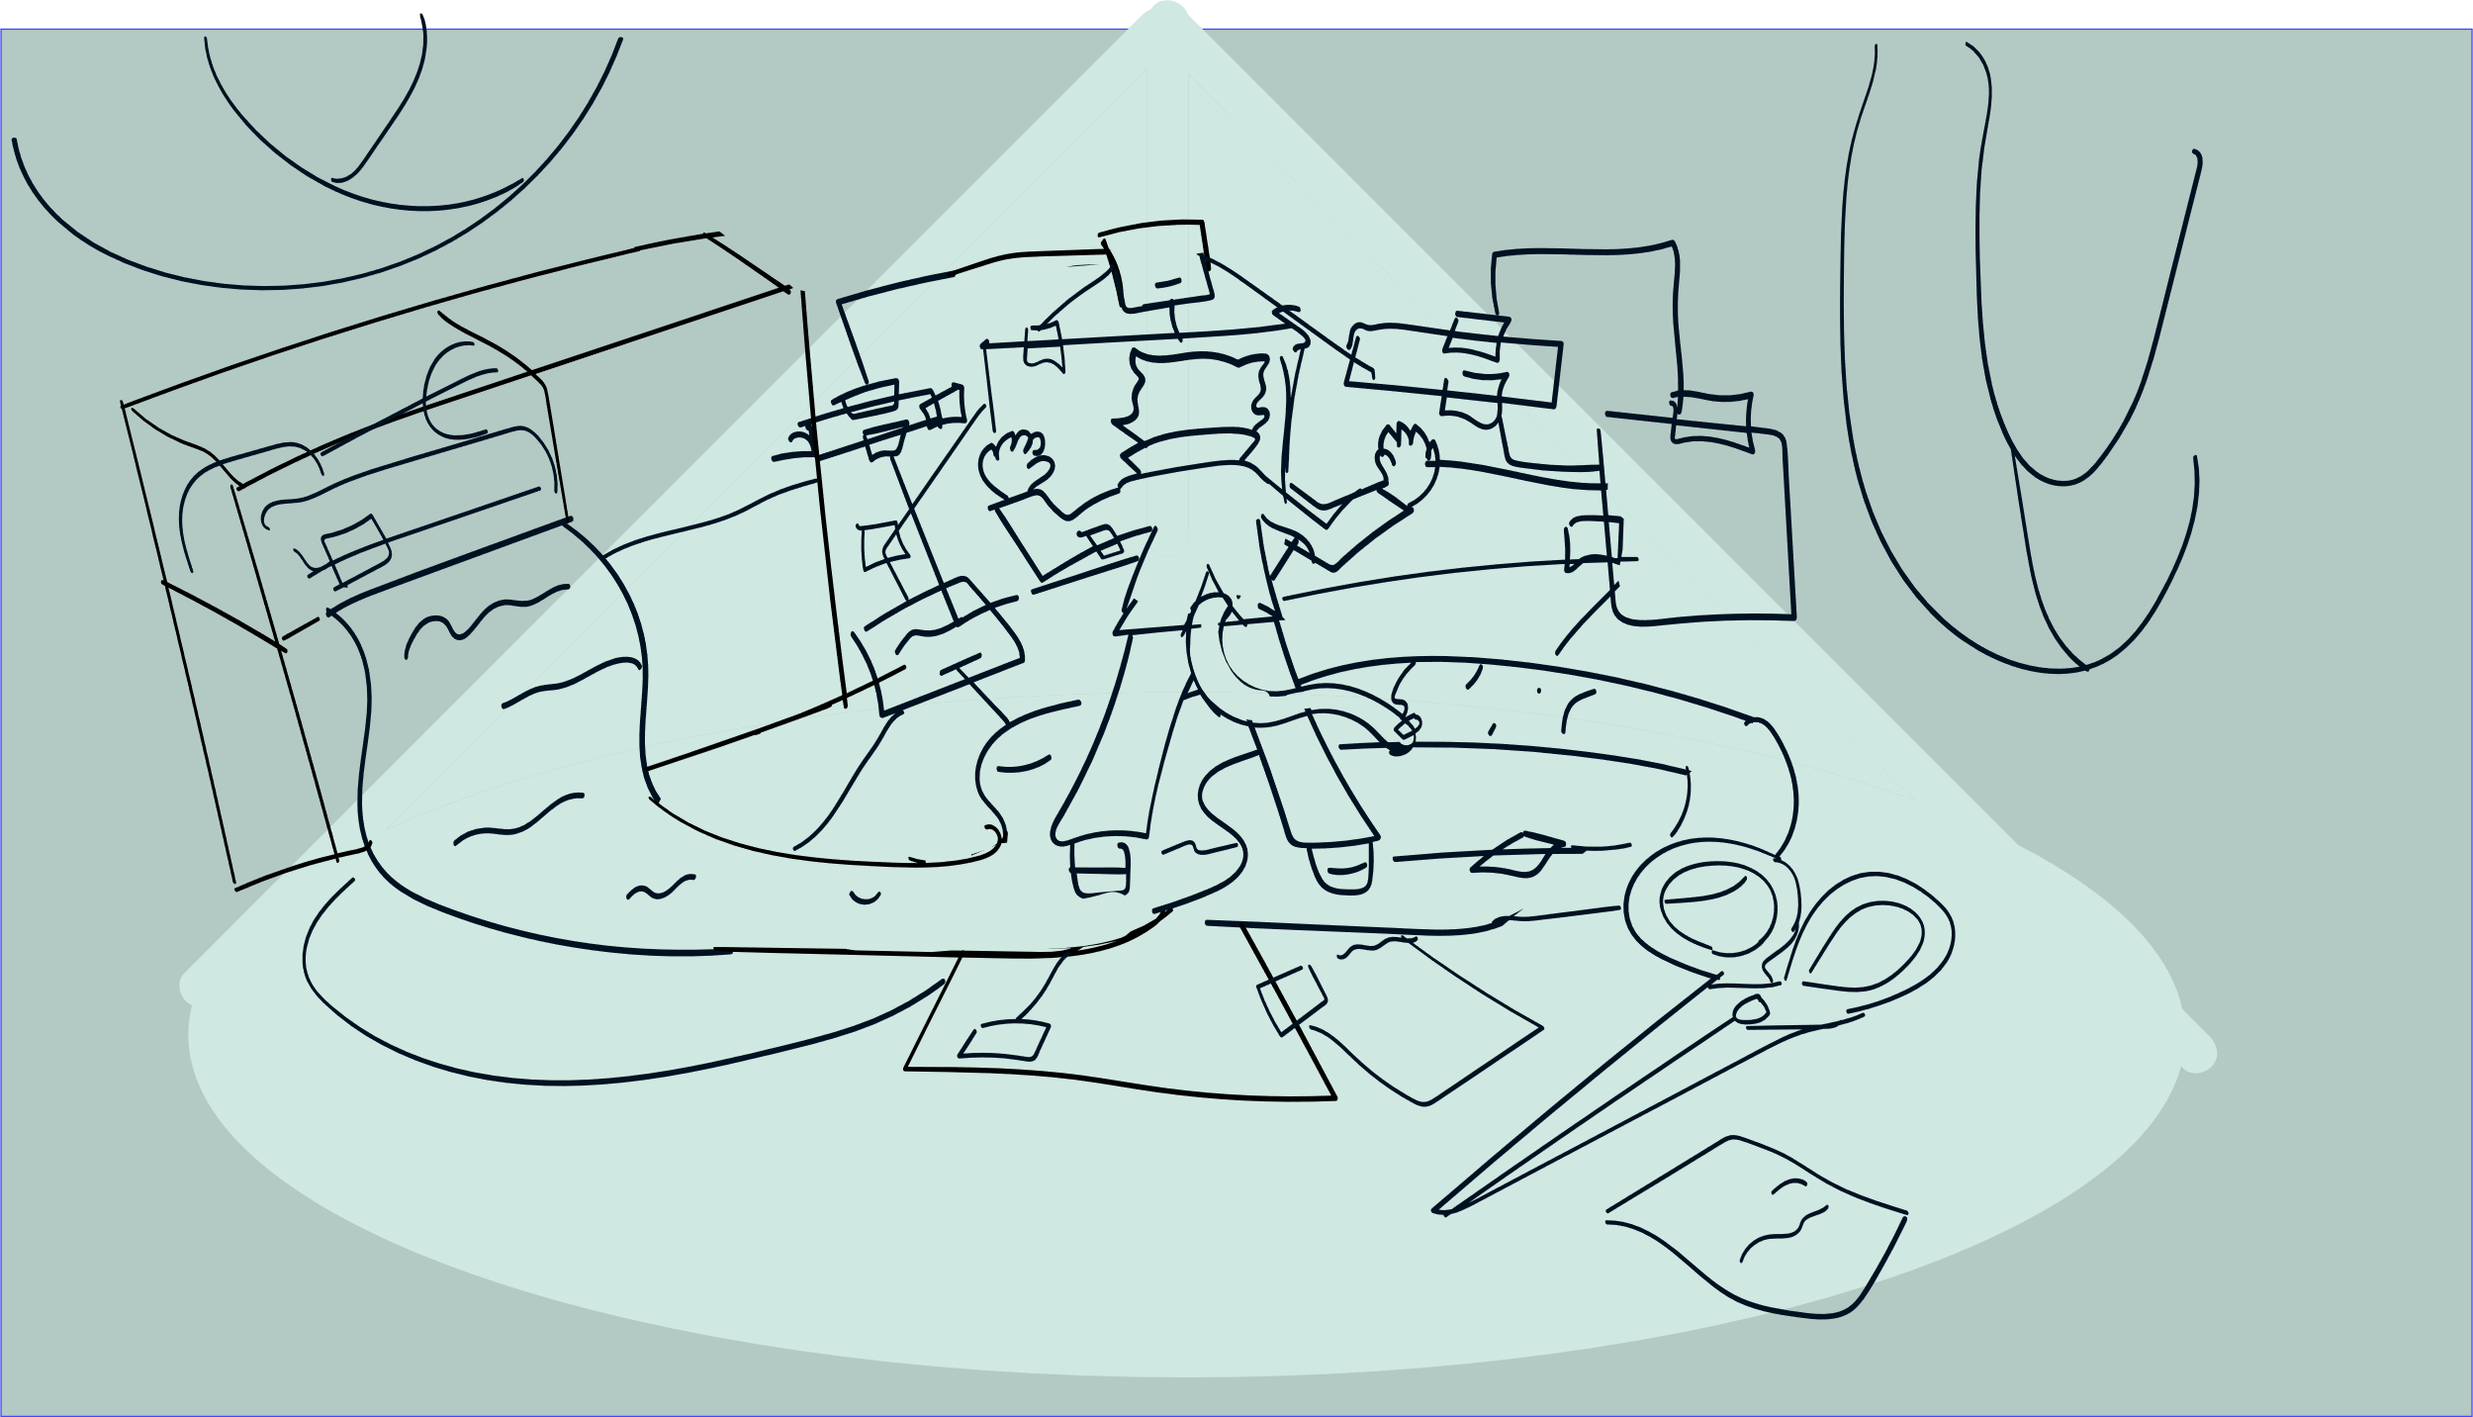



I CAN WRITE CODE THAT CAN DO THAT IN MILLISECONDS…
OH REALLY, MY FURRY FRIEND? I TRIPLE-DOG DARE YOU TO DO IT.
YOU LIVE IN THE STONE AGE!
MY PLAN IS SIMPLE YET BEAUTIFUL. I’M GOING TO FIND THE FOUNTAIN OF YOUTH IN FLORIDA BY ANALYZING DATA SUBSETS.
STEP ONE IS TO CREATE THESE GROUPS BY CUTTING UP THIS PRINTOUT AND TAPING THEM BACK TOGETHER.

Slide 5



THERE ARE TIMES IN A DOG’S LIFE WHEN SHE MUST STAND FOR TRUTH, JUSTICE, AND THE CANINE WAY…

Slide 6

